Slide 1


MOTHER THERESA INSTITUTE OF COMPUTER APPLICATIONS
(Affiliated to S.V.University ,Tirupati)
Melumoi,Palamaneru-517408 ,Chittoor Dist. (A.P)
2021-2023
A Seminar Presentation
On
Wireless Application Protocol
Submitted BY:
GUIDED BY:
MR R.PRABHAKAR NAIDU,MCA,(PhD);
SHAIK ARSHAD
Reg no:2721104

Slide 2
Objectives:
Wireless Application Protocol
WAP:Main Feature
WAP Architecture
Advantages Of WAP
Disadvantages Of WAP
Conclusion

Slide 3
Wireless Application Protocol
Wireless Application Protocol commonly
known as WAP is used to enable the access
of internet in the mobile phones or PDAs.
An open, global specification that empowers
mobiles users with wireless devices to easily
access and interact with internet information
and services instantly.

Slide 4
Cont….
WAP is an application communication protocol
WAP is used to access services and information
WAP is for handheld devices such as mobile phones
WAP enables the creating of web application for
mobile devices.
WAP uses the mark-up language WML(not HTML)

Slide 5
WAP:Main Features
Browser
“Micro browser”,similar to existing web browser
Markup language
Similar to HTML_adapted to mobile devices
Script language
Similar to javascript,adapted to mobile devices
Gateway
Transition from wireless to wired world

Slide 6
Server
“Wap/origin server”,similar to existing
web servers
Protocol layers
Transport layer,security layer, session
layer etc.
Telephone application interface
Access to telephone functions

Slide 7
WAP Architecture Requirements
Define a layered, scaleable and extensible
architecture.
Support as many wireless networks as possible
Optimize for narrow-band bearers with high
latency
Optimize for efficient use of device resources
Provide support for secure application and
communication

Slide 8
World-Wide Web Model
Web server
Client
Request
(URL)
CGL,
Web
Script,
Browser
Etc.
Response
(Content)
Content

Slide 9
WAP Programming Model
Web server
Client
Gateway
Request
Encoded
(URL)
CGL,
Request
Encoders
Scripts,
User
And
Etc.
Agent
Decoders
Encoded
Response
Response
(Content)
Content

Slide 10
WAP Proxy
Protocol gateway translates requests from the
WAP protocol stack to WWW protocol stack.
Content encoders and decoders translate WAP
into compact encoded formats to reduce the
size of data over the network

Slide 11
WAP Devices
Is used to access WAP application and content.
It might be a PDA, handheld computer.
WAP Client
Entity that receives content from internet via a
it might be a PDA, handheld computer.

Slide 12
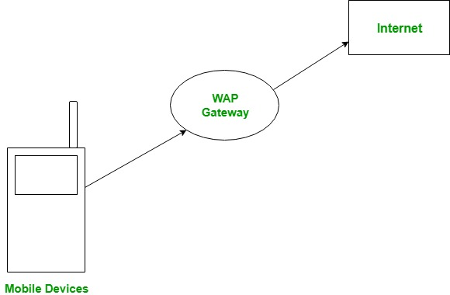
WAP Gateway
Interface between mobile devices and internet

Slide 13
WAP Gateway
It receives directly from the clients as if it is
actually were the origin server that clients
want to information.
WAP Browser
Software running on the WAP devices that
interpreted the WAP content arriving from
the internet.

Slide 14
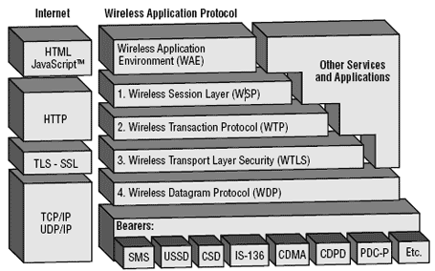
WAP Architecture

Slide 15
Architecture Overview
WWW programming model is optimized and
extended to match characteristics of the
wireless environment.
Utilizes proxy technology to connect between
the wireless domain and WWW.

Slide 16
Usage
Corporate Application: Sales forces
automation where sales people use their WAP
enabled handsets to get instant.
Online Services:
Banking: User can get their current balance,
transfer funds between accounts and receive
tax statements.
Electronic Commerce: Customers can use their
handset just like PC to purchase products and
services.

Slide 17
Tale Services
Prepaid services with a WAP enabled phone,
prepaid customer can see their current balance
with the press of a button.
Personal Productivity
Email using WAP users can keep track of their
email right from their handset.

Slide 18
Advantages
Implementation near to the internet model
Most modern mobile telephone devices support WAP
Real-time send/receive data
Multiplatform functionality
Flexible internet.

Slide 19
Disadvantages
Low speed, security and very small user interface
Not very familiar to the users
Business model is expensive
Forms are hard to design
Third party is include.

Slide 20
Conclusion
In conclusion,WAP is suitable for the creation of
mobile learning training course material.
The optimization of WAP and the handling of the
design mobile handheld devices for distance
learning in real-time.
The application developer must always be aware
of the user.

Slide 21

THANK YOU
Any Questions!!!

